Slide 1
Internet & Web
Lab 9: Internet

Slide 2


Welcome to Internet & Web Class

Slide 3

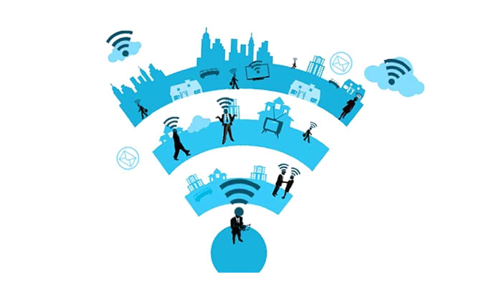
Connectivity
A generic term for connecting devices to each other in order to transfer data back and forth.
It often refers to network connections

Slide 4
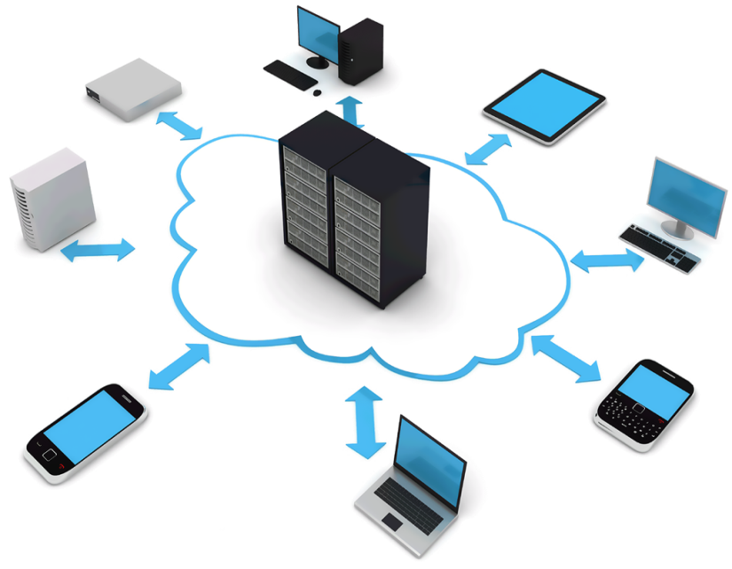
What is Internet Access?
The ability of individuals and organizations to connect to the Internet using computer terminals, computers, and other devices; and to access services such as email and the World Wide Web.

Slide 5
Internet Connection Type

Slide 6
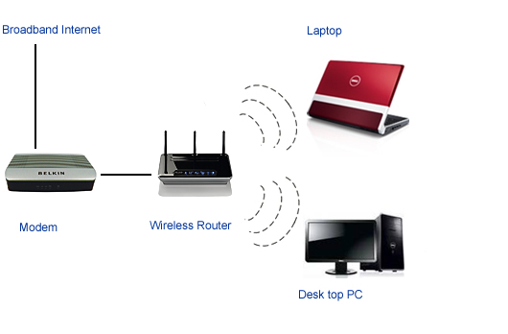
Wireless
"always-on" connection
Wireless connections are made possible through the
use of a modem,
which picks up
Internet signals
and sends them
to other devices

Slide 7
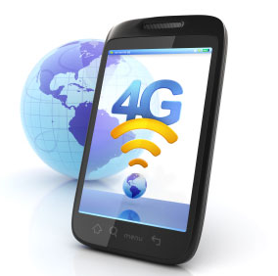
Mobile
Good Speed
Cell phone and Smartphone providers offer voice plans
with Internet access.

Slide 8
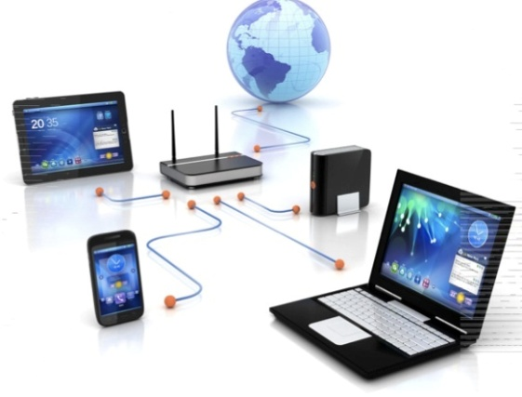
Broadband
Very High
Speed
Broadband Internet uses multiple data channels to send large quantities of information. Connection
is provided through
either cable or
telephone companies.

Slide 9
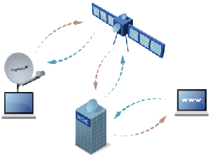
Satellite
Speed
512Kb-2 Mb
Similar to wireless access, satellite connection utilizes a modem. Satellite connection . In certain
areas where broadband
connection is not yet
offered, a satellite
Internet option may be
available

Slide 10

Bandwidth
Bandwidth is the maximum rate of data transfer across a given path.
Bandwidth can be compared to the amount of water that can flow through a water pipe. The bigger the pipe, the more water can flow through it at one time. Bandwidth works on the same principle.

Slide 11

Today’s learning:
Connectivity
Internet Access
Connection Type
Bandwidth
Thank You!

